Slide 1
. Detecting Deception
Trevor Slater
Chief Operations Officer

Slide 2
Personality Styles
This person is intellectual, objective, rational and a good decision maker.
This person is steady, dependable, conservative and has perseverance.
This person is dissatisfied with the status quo, believes in no nonsense behaviour and tends to takes risks
This person is strongly preoccupied with sex and booze

Slide 3
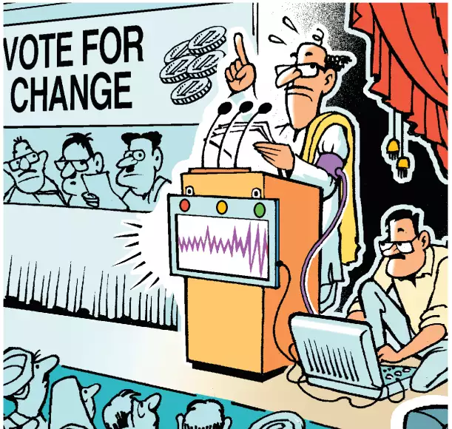
Detecting Deception

Slide 4
Who has the children?
Mum and Dad are separated
Their children have gone missing
One of the parents has them

Slide 5
DETECTING DECEPTION
Why is it important to know if someone is telling us the ‘truth’?

Slide 6
DETECTING DECEPTION
In the first instance or in a pure version statement…
“Nobody ever lies, they just simply leave out information”

Slide 7
DETECTING DECEPTION
MISSING INFORMATION INDICATORS
Answering the question by not answering the question
Q: Did you tell our customer service person that you had changed your email address?
A: He knew all about my changed circumstances.

Slide 8
DETECTING DECEPTION
A change of pace/time in a written statement or information out of sequence
A statement time speeds up and slows down
measure the number of lines per hour and look for when it slows down or becomes faster
A statement time that is not chronological
starts in the AM moves to the PM and back to the AM

Slide 9
DETECTING DECEPTION
Missing time = Missing Information
“a short time later”
“after a little while”
“afterwards”
“the next thing I knew”

Slide 10
DETECTING DECEPTION
Changing pronouns or statement tense
Changing from ‘my’ to ‘the’ indicates distance and non-ownership of subject
From ‘I’ to ‘we’ with no explanation – who is ‘we’
From ‘I did something’ to ‘I would have done….’ (future tense sentence in a past tense statement) is not a true reflection of what happened

Slide 11
DETECTING DECEPTION
Declaration of Innocence
“I didn’t do it.”
“I am telling you the truth”
Must be said prior to teaching the person to lie, i.e. in the pure version statement

Slide 12
DETECTING DECEPTION
An out of place overstatement of innocent
“I want you to know…
“I was always taught to be honest.”
“I would never lie”

Slide 13
DETECTING DECEPTION
Examples……
OJ Simpson – who did he kill?
Lindy Chamberlin – did she?

Slide 14
DETECTING DECEPTION
Examples - Oscar Pistorius – lost time?
I heard the window opening in the bathroom. The sliding window hit against the edge, indicating it could open no further. That is the moment that everything changed.
I froze. I didn’t know what to do. I was looking down the passage scared the person was going to come out. I grabbed a firearm from underneath the bed. I wanted to get back to where the passage was. To get myself between the person or people and Reeva.
I just stayed where I was and kept screaming. Then I heard a noise from inside the toilet that I perceived to be somebody coming out of the toilet. Before I knew it I had fired four shots at the door.
I didn’t know if someone else would come in through the window to attacked Reeva and I called out to Reeva but I couldn’t hear anything.

Slide 15
DETECTING DECEPTION
THE MOST IMPORTANT RULE OF SCAN
DO NOT USE IT ON FRIENDS OR FAMILY

Slide 16
Trevor Slater
Chief Operations Officer

